Slide 1
Journey to:
Heart Diseases
Let's explore some features related to

Slide 2
The OutLine:
Our Data Set
Our Problem
Desired Outcome
We will introduce some important info about our data set.
We mainly need to highlight the relation between this disease and some features.
Clear overview of our data and how each feature affects others.

Slide 3
01
Exploring Our Data
Let's take advantage to know more about our data..

Slide 4
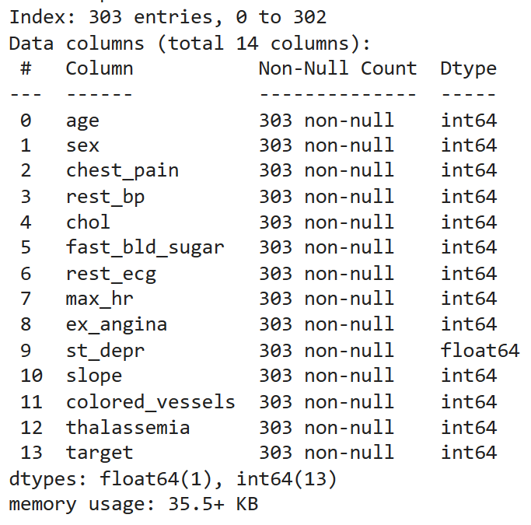
Describe:
We can see here the main characteristic information about our data.

Slide 5
What do you think about the number of samples in our dataset?

Slide 6
303Entries
What do you think about the number of samples in our dataset?

Slide 7
303Entries
What do you think about the number of samples in our dataset?
What about the number of features?

Slide 8
303Entries
14 Columns
What do you think about the number of samples in our dataset?
What about the number of features?

Slide 9
Table of Features:

Slide 10
Table of Features:
01
02
03
age
sex
chest_pain
04
05
06
rest_bp
chol
fast_bld_sugar
In years
Gender
3 Categories
Quantitative Value
Quantitative Value
You can describe the topic of the section here

Slide 11
Table of Features:
07
08
09
rest_ecg
max_hr
ex_angina
10
11
12
st_depr
slope
colored_vessels
You can describe the topic of the section here
Quantitative Value
You can describe the topic of the section here
Quantitative Value
You can describe the topic of the section here
You can describe the topic of the section here

Slide 12
Table of Features:
13
14
thalassemia
target
You can describe the topic of the section here
You can describe the topic of the section here

Slide 13
02
What is Our Problem?
What do we need from this visualization?

Slide 14
What we need:
Understand
Gain a deeper understanding of the Heart Disease data through analysis.

Slide 15
What we need:
Understand
Discover
Gain a deeper understanding of the Heart Disease data through analysis.
Discover trends and relationships between the different features in the dataset.

Slide 16
03
What is Our Desired Outcome?
What do we expect after this visualizations?

Slide 17
Expect:
Identify potential risk factors
01

Slide 18
Expect:
Identify potential risk factors
Detect
outliers
01
02

Slide 19
Expect:
Identify potential risk factors
Detect
outliers
Explore normality of data
01
02
03

Slide 20
Expect:
Identify potential risk factors
Detect
outliers
Explore normality of data
Enhance communication between complex findings
01
02
03
04

Slide 21
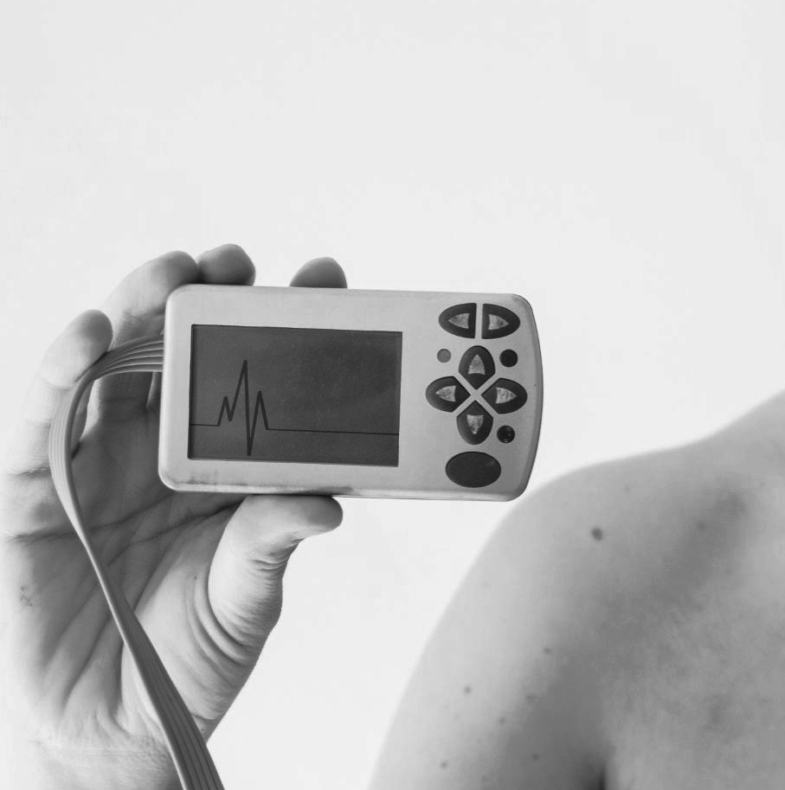
Why
should
I care!?
Let's delve deeper and discover the reasons why data visualization of heart disease is something you should be interested in.

Slide 22
Which matters to you:
1
2
3
4
Improved treatment strategies
Predicts heart disease risk
can lead to earlier diagnosis, more effective interventions
ultimately, fewer deaths from heart disease

Slide 23
Which matters to you:
1
2
3
4
Improved treatment strategies
Predicts heart disease risk
can lead to earlier diagnosis, more effective interventions
ultimately, fewer deaths from heart disease

Slide 24
Which matters to you:
1
2
3
4
Improved treatment strategies
Predicts heart disease risk
can lead to earlier diagnosis, more effective interventions
ultimately, fewer deaths from heart disease

Slide 25
Which matters to you:
1
2
3
4
Improved treatment strategies
Predicts heart disease risk
can lead to earlier diagnosis, more effective interventions
ultimately, fewer deaths from heart disease

Slide 26
Ready to
start
our
Journey!

Slide 27
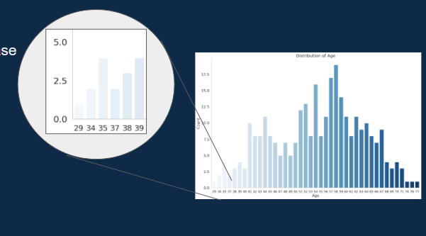
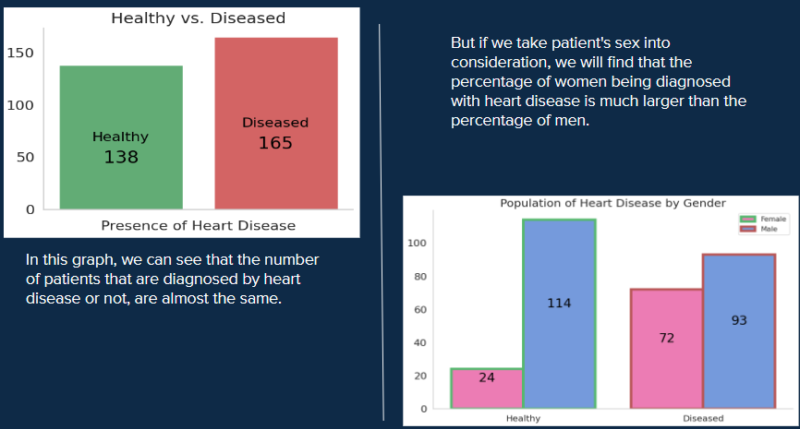
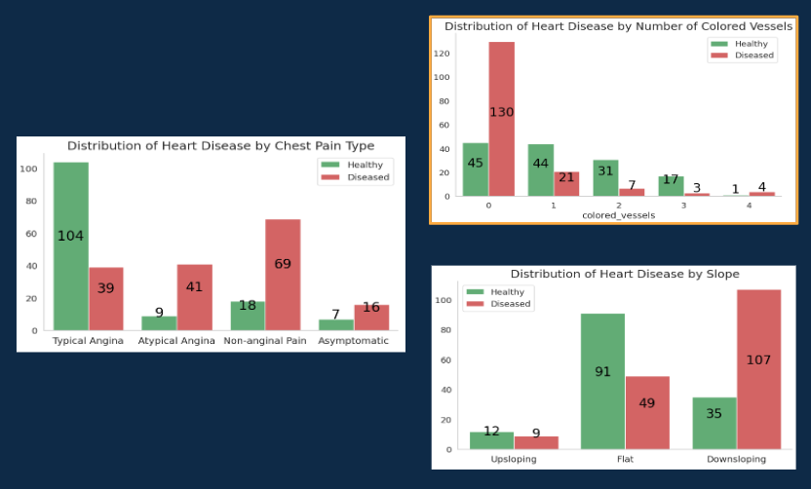
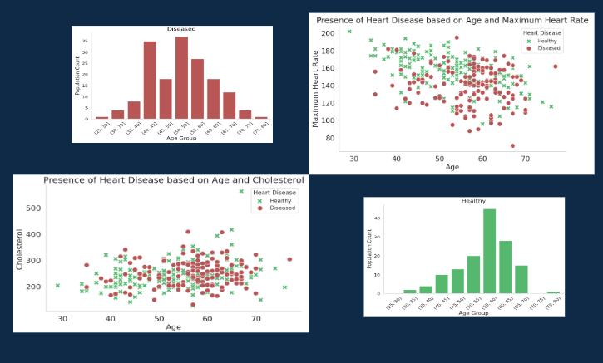
OutLines:
Main Observations:
Comparison
Categorized Features
Relational
Age
Gender
Health State
Age VS Cholesterol
Maximum Heart Rate
Chest Pain
Colored Vessels
Slope

Slide 28
01
Main Observations:

Slide 29
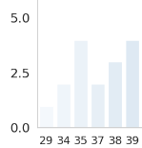
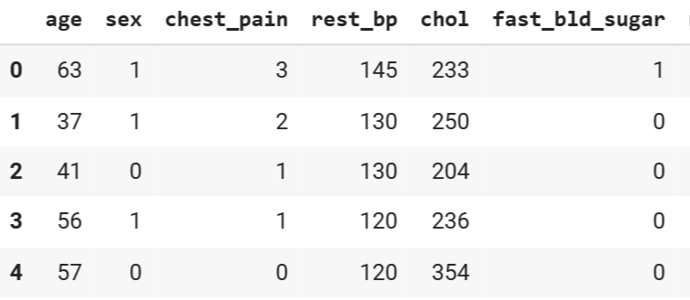
Our DataSet..

Slide 30
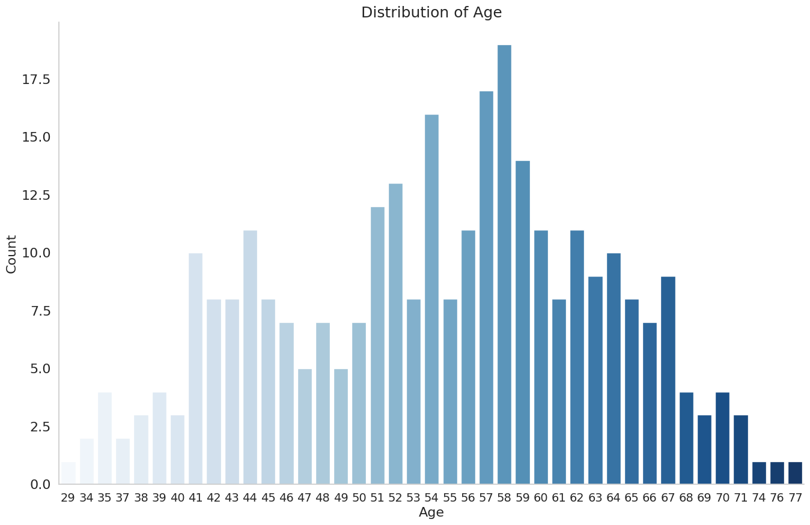
Revelations from Our Data
Youth Afflicted: Heart disease
in 29-year-olds.

Slide 31

Revelations from Our Data
Gender Gap: Men's heart disease rates
eclipse women's.
Cholesterol Extreme: Levels hitting 564 mg/dL.

Slide 32
Revelations from Our Data
Normal BP, Hidden Risk: Normal pressure, yet widespread
heart disease

Slide 33
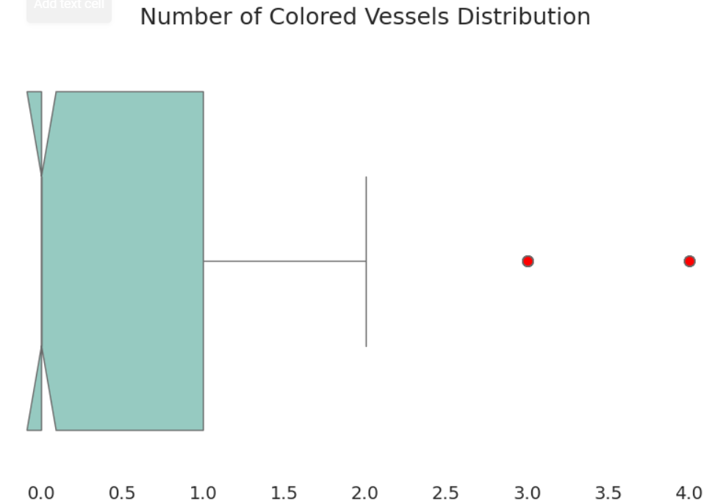
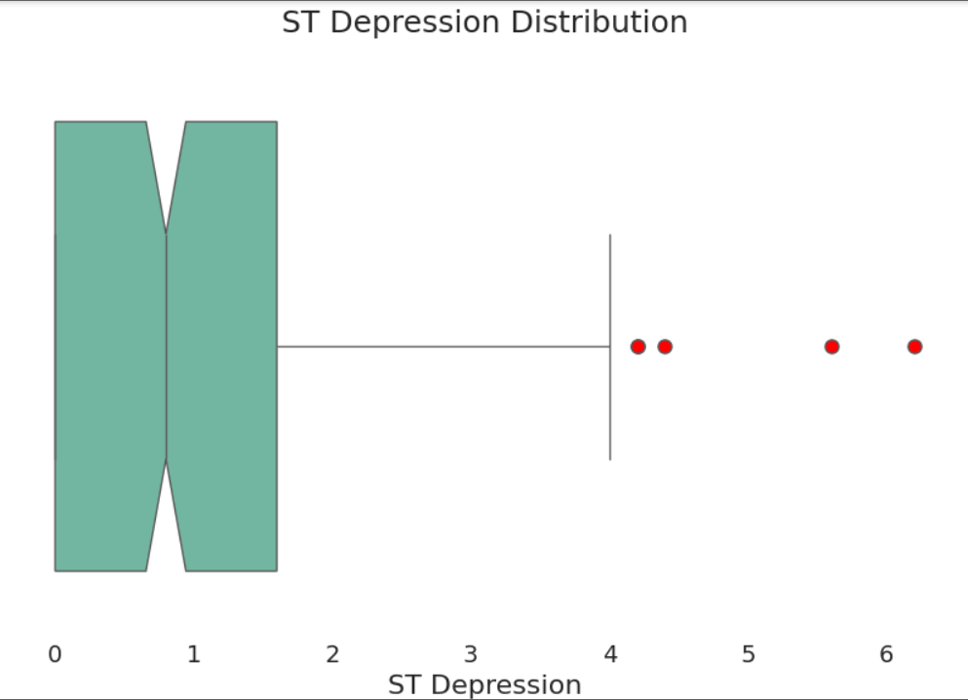
Data Insights :
ST Depression Distribution
Number of Colored Vessels Distribution

Slide 34
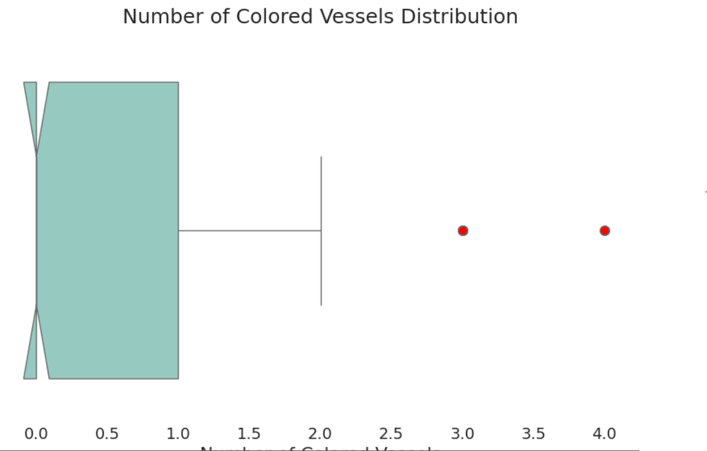
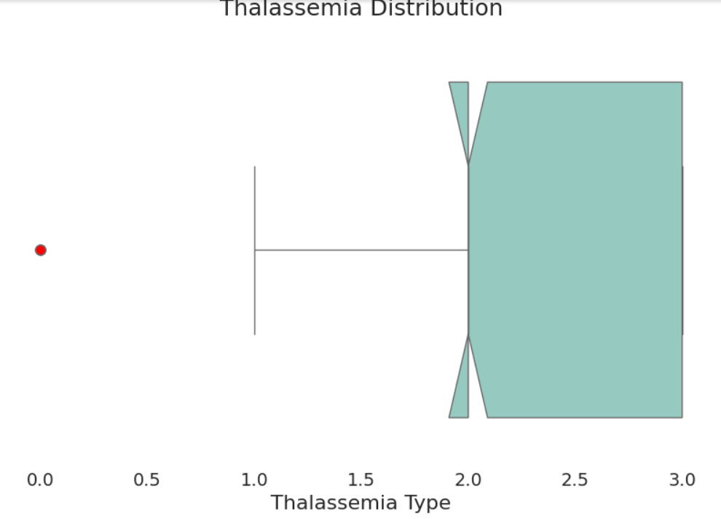
Data Insights :
Distribution of Cholesterol Levels
Thalassemia Distribution

Slide 35
Age:
Population Count
Age (years)

Slide 36
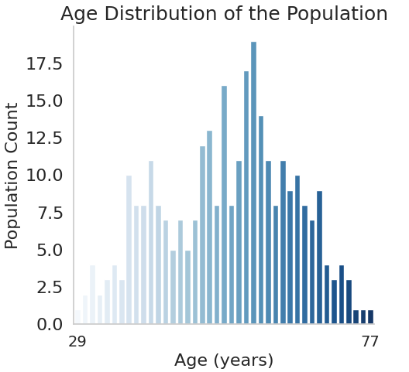
Age:
Population Count
Age (years)
Observation:
Our dataset has a wide range of different ages, so we sure that our sample will not be biased for specific age.

Slide 37
Gender:
Male
Female

Slide 38
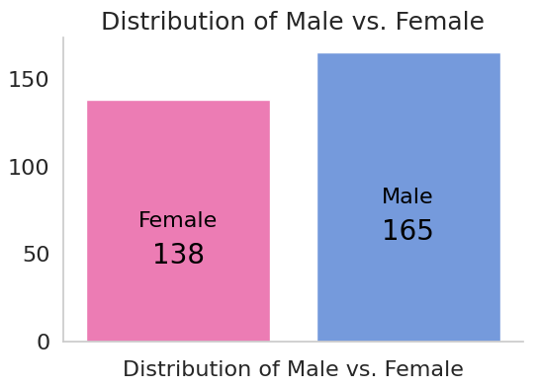
Gender:
Male
Female
Observation:
We can note small difference in the distribution between males and females, but still this difference is very small. Which will not lead to biasing in our data.

Slide 39
Health Status:
Healthy
Diseased

Slide 40
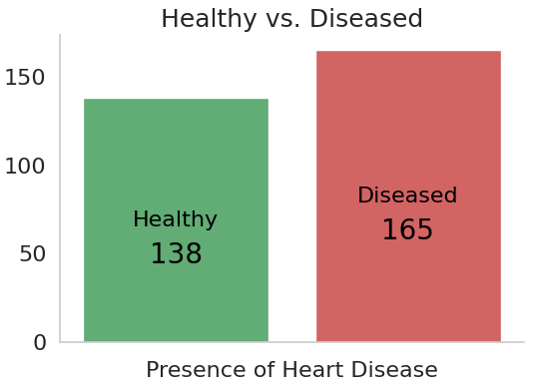
Healthy Status:
Healthy
Diseased
Observation:
The graph indicates a higher prevalence of disease compared to healthy individuals.

Slide 41
Heart Disease by Gender:
Healthy
Diseased

Slide 42
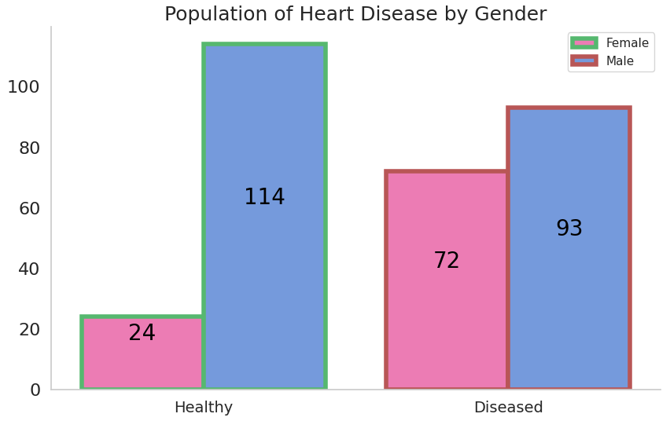
Heart Disease by Gender:
Healthy
Diseased
Observation:
We can note small difference in the distribution between males and females, but still this difference is very small. Which will not lead to biasing of our data.

Slide 43
But if we take patient's sex into consideration, we will find that the percentage of women being diagnosed with heart disease is much larger than the percentage of men.
In this graph, we can see that the number of patients that are diagnosed by heart disease or not, are almost the same.

Slide 44
02
Categorized Features

Slide 45
Some diseases have different categories

Slide 46
Some diseases have different categories
Chest pain type

Slide 47
Some diseases have different categories
Chest pain type
Number of Colored Vessels

Slide 48
Some diseases have different categories
Chest pain type
Number of Colored Vessels
The slope of ST segment

Slide 49
“Go Through These Categories:”

Slide 50
Chest pain type
Typical angina
Atypical angina
Non-anginal
pain
Asymptomatic

Slide 51
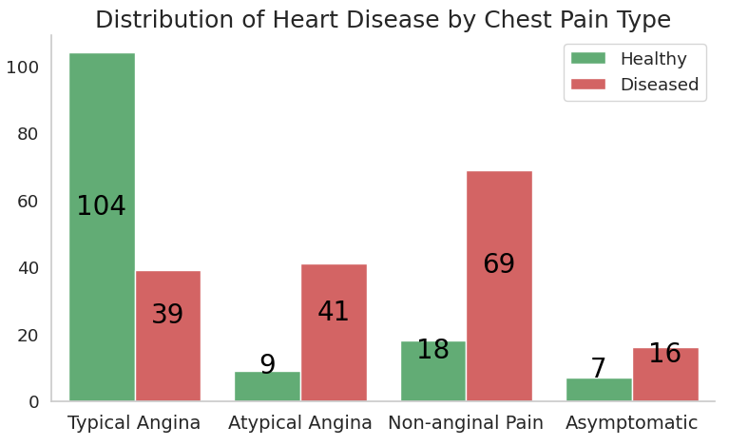
Chest pain type
Observation:
By seeing the distribution of Heart Disease by Chest Pain Type, we have 4 chest pain types as shown in the graph.
People who have Typical Angina Chest Pain are least likely to have Heart Disease, on the contrary, people who have Non-anginal Chest Pain are more likely to have Heart Disease.

Slide 52
Resting ECG results
Normal
depression of > 0.05 mV
left ventricular hypertrophy by Estes' criteria

Slide 53
Number of Colored Vessels
1
2
3
4

Slide 54
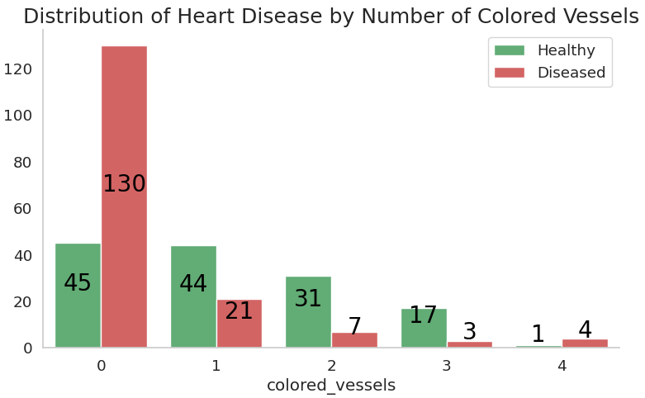
Number of Colored Vessels
Observation:
The distribution of Heart Disease by Number of Colored Vessels shows that the fewer the Number of Colored Vessels the more likely the patients to have Heart Disease, and vice versa, this implies a strong negative correlation between colored vessels and heart disease.

Slide 55
The slope of the peak exercise ST segment
Upsloping
Flat
Downsloping

Slide 56
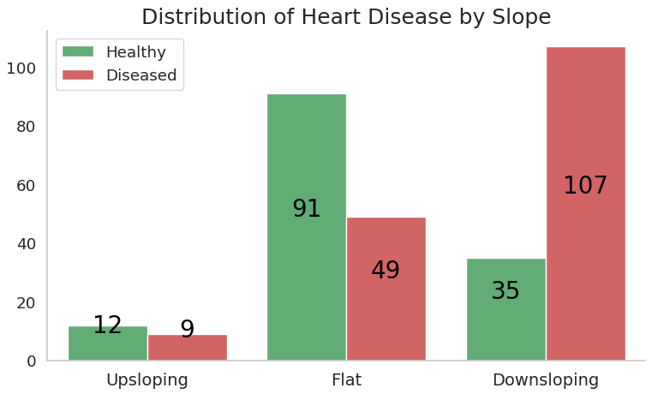
The slope of ST segment
Observation:
The previous graph indicates a clear link between heart disease and post-peak exercise, since the majority of individuals with a downward slope of the ST segment had been diagnosed with the condition. The majority of patients with a flat line did not receive a heart disease diagnosis, while the fewest patients had an upward slope.

Slide 57
03
The Relation between two different Features

Slide 58
Based on:
Age
Cholesterol
01
02

Slide 59
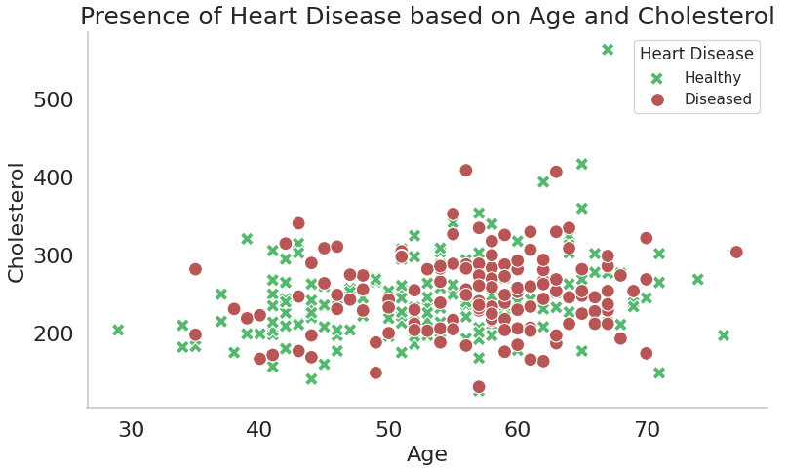
Age VS Cholesterol
Observation:
This graph represents the Presence of Heart Disease based on Age and Cholesterol, as we can see, there is no clear pattern between age and Cholesterol.
The points are scattered over the interval.

Slide 60
Based on:
Age
Maximum Heart Rate
01
02

Slide 61
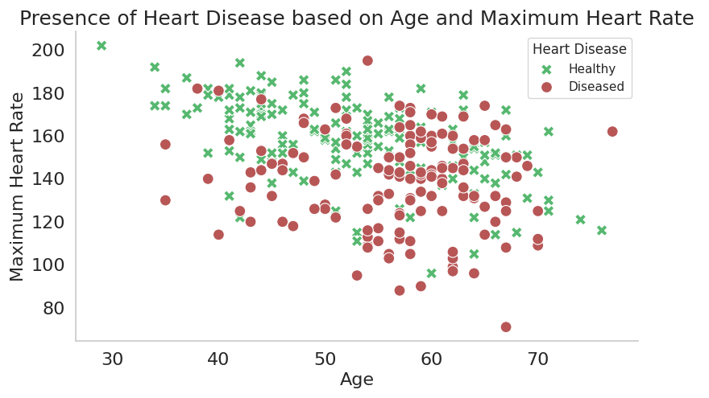
Age VS Maximum Heart Rate
Observation:
This graph shows the Presence of Heart Disease based on Age and Maximum Heart Rate, however, there’s no clear pattern can be noticed from this graph, the points are randomly distributed over the interval, but we can see that there are many patients with heart disease seem to be on the younger side. We can conclude that, surprisingly, this disease does not depend clearly on age.

Slide 62
Based on:
Age
Disease
&
Healthy
01
02

Slide 63
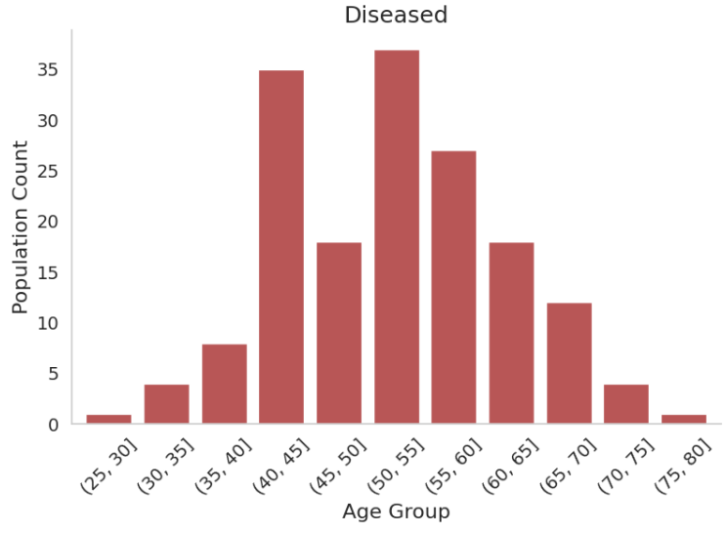
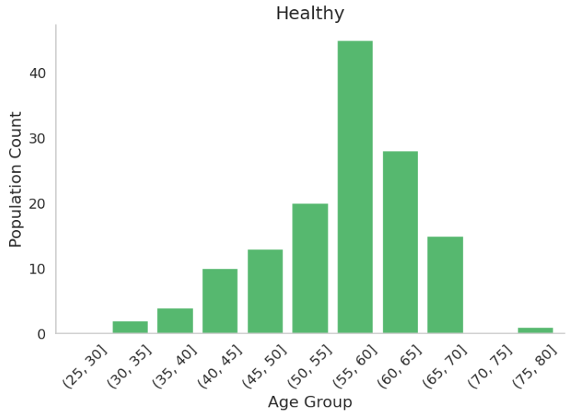
“Age” VS “Disease & Healthy”

Slide 64
“Age” VS “Disease & Healthy”
As we can see, this is a different visualization for the previous graph, which makes it more obvious that Heart Disease doesn’t have strong correlation with age.

Slide 65
What we can do
we need to launch awareness campaigns on the importance of regular heart disease screening for all ages
we need to intensify research on the causes of heart diseases in young people for prevention
01
02

Slide 66
04
Observing Correlations with a Heatmap

Slide 67
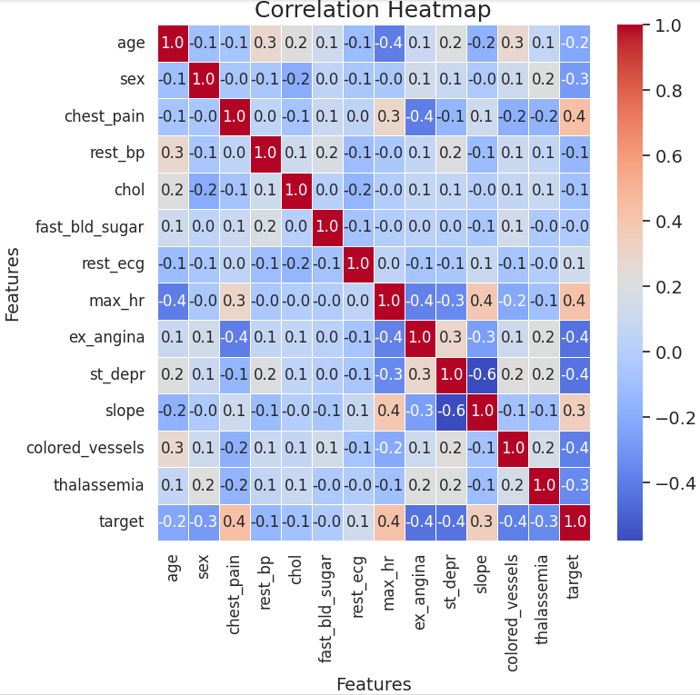

Slide 68
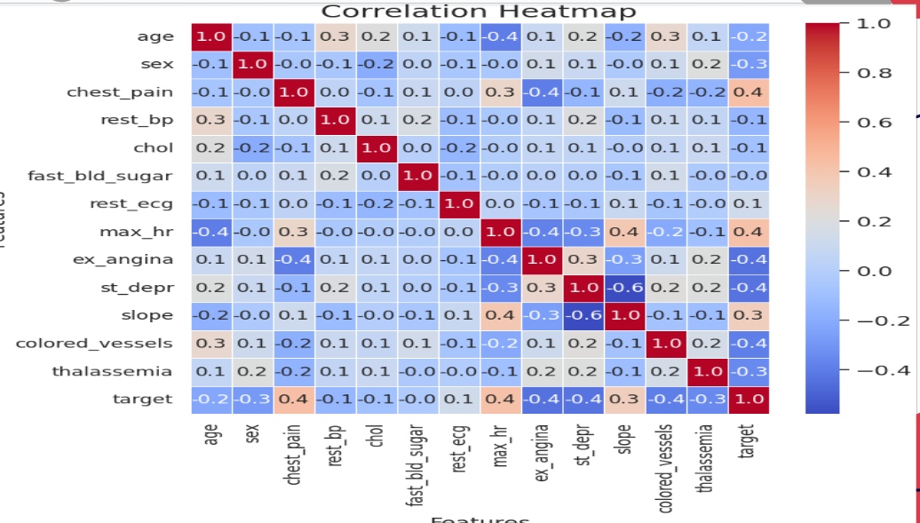
Observation:
From the heatmap, we can observe correlations between different features and the target column. Notably, features such as chest pain, max_hr, and slope demonstrate positive correlations with the target column.

Slide 69
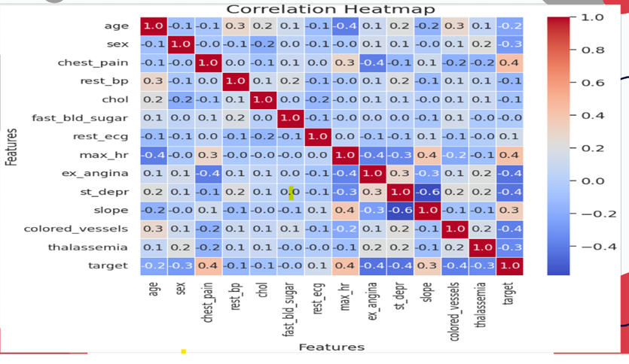
Observation:
Chest Pain (CP):
There exists a moderately strong positive correlation (correlation coefficient ≈ 0.4) between chest pain severity and the likelihood of heart disease. Patients experiencing more severe chest pain tend to have a higher risk of heart disease.

Slide 70
Observation:
Max Heart Rate (Max_HR)
A moderate positive correlation (correlation coefficient ≈ 0.4) is present between the maximum heart rate achieved during an exercise test and the likelihood of heart disease. Higher maximum heart rates may indicate increased stress on the heart, potentially associated with a higher risk of heart disease.

Slide 71
Observation:
Slope:
The slope of the peak exercise ST segment on the electrocardiogram demonstrates a moderate positive correlation (correlation coefficient ≈ 0.3) with the likelihood of heart disease. Certain slope patterns, possibly indicating ischemia or abnormal blood flow to the heart, are associated with a higher risk of heart disease.

Slide 72
Conclusion:

Slide 73

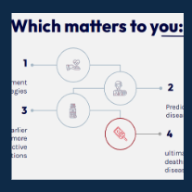
Recap:
Our Data
Our Problem
OutCome

Slide 74
Recap:
Comparison
Categorized Features
Relational
Age
Gender
Health State
Chest Pain
Colored Vessels
Slope
Age VS Cholesterol
Maximum Heart Rate

Slide 75
Tableau dashboard :
https://public.tableau.com/app/profile/nada.nabil/viz/Readingassigment_Stat2024_ch7_heartattak/Dashboard1?publish=yes

Slide 76
Thanks.
Rghda Salah 202101510
Mahmoud Mohamed 202100678
Nada Nabil 202101220
Tasneem Muhammad 202101031
Mariam Ismael 202101506

